Slide 1
Predicting Hospital Mortality using Multiparameter Intelligent Monitoring in Intensive Care (MIMIC3) Dataset
John Mathew (20MCB1001)
Rohan Gurubhaiye (20MCB1012)
Heer Mapara (20MCB1019)

Slide 2
Content
Introduction
Architecture
Modules
Sample Workout
Comparative Results
Challenges
Outcome of Project
Conclusion

Slide 3
Introduction
The MIMIC III (Multiparameter Intelligent Monitoring in Intensive Care) Databases contain physiologic signals and vital signs time series captured from patient monitors, and comprehensive clinical data obtained from hospital medical information systems, for tens of thousands of Intensive Care Unit (ICU) patients.
Using this Data of various patient we can study the pattern of patients recovery.
The dataset consists of 28 attributes including the unique id column and 58975 instances in total.

Slide 4
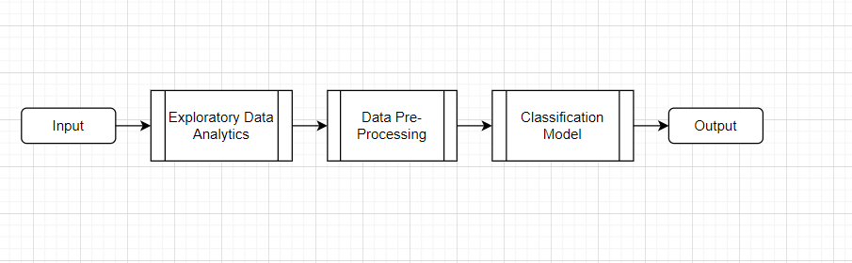
Architecture

Slide 5
Modules
Strategy: Matching the problem with the solution.
Data collection. Dataset preparation and preprocessing. Data visualization.
Data selection. Data transformation. Dataset splitting.
Modeling. Model training. Model evaluation and testing. Improving predictions with ensemble methods.

Slide 6
Random Forest Algorithm
Random Forest is a popular machine learning algorithm that belongs to the supervised learning technique. It can be used for both Classification and Regression problems in ML. It is based on the concept of ensemble learning, which is a process of combining multiple classifiers to solve a complex problem and to improve the performance of the model. As the name suggests, “ Random Forest is a classifier that contains a number of decision trees on various subsets of the given dataset and takes the average to improve the predictive accuracy of that dataset.” Instead of relying on one decision tree, the random forest takes the prediction from each tree and based on the majority votes of predictions, and it predicts the final output. The greater number of trees in the forest leads to higher accuracy and prevents the problem of overfitting.

Slide 7
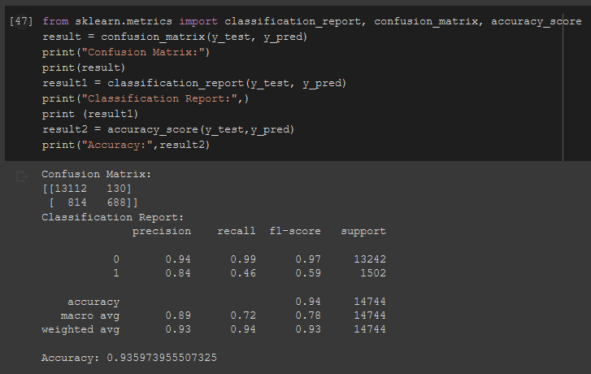
Random Forest Implementation Metrics

Slide 8
Decision Tree Classification
Decision Tree algorithm belongs to the family of supervised learning algorithms. Unlike other supervised learning algorithms, the decision tree algorithm can be used for solving regression and classification problems too.
The goal of using a Decision Tree is to create a training model that can use to predict the class or value of the target variable by learning simple decision rules inferred from prior data(training data).
In Decision Trees, for predicting a class label for a record we start from the root of the tree. We compare the values of the root attribute with the record’s attribute. On the basis of comparison, we follow the branch corresponding to that value and jump to the next node.

Slide 9
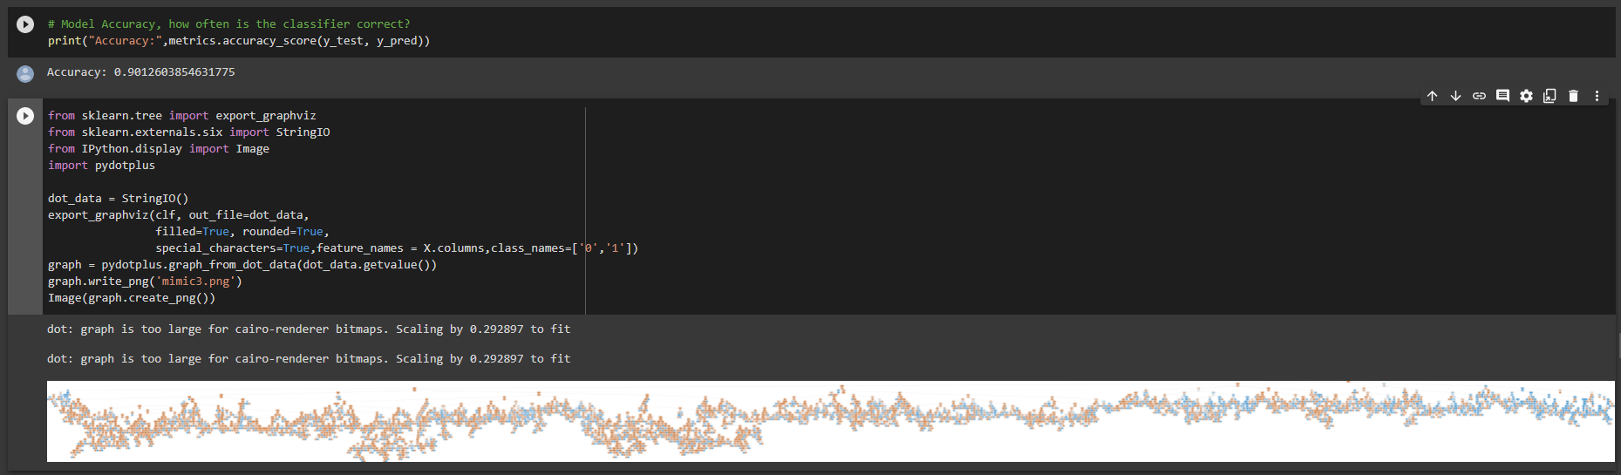
Decision Tree Classification Implementation

Slide 10
SUPPORT VECTOR MACHINE (SVM)
The objective of the support vector machine algorithm is to find a hyperplane in an N-dimensional space(N — the number of features) that distinctly classifies the data points.
To separate the two classes of data points, there are many possible hyperplanes that could be chosen. Our objective is to find a plane that has the maximum margin, i.e the maximum distance between data points of both classes. Maximizing the margin distance provides some reinforcement so that future data points can be classified with more confidence.

Slide 11
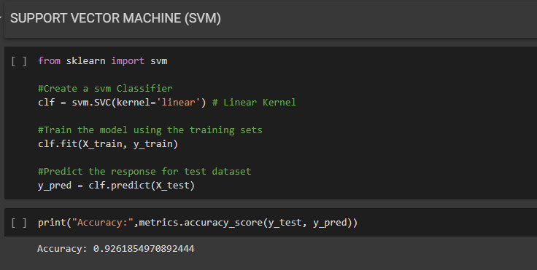
SUPPORT VECTOR MACHINE (SVM)

Slide 12
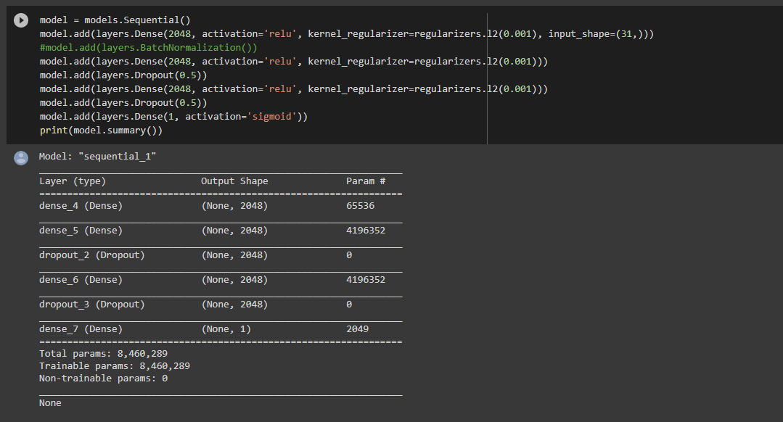
Sequential Neural Network Model

Slide 13
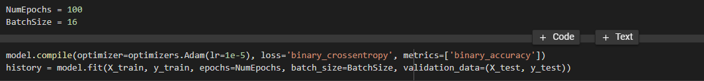
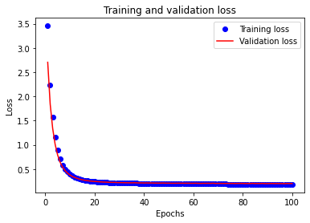
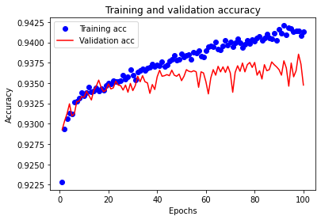
Neural Network Model

Slide 14
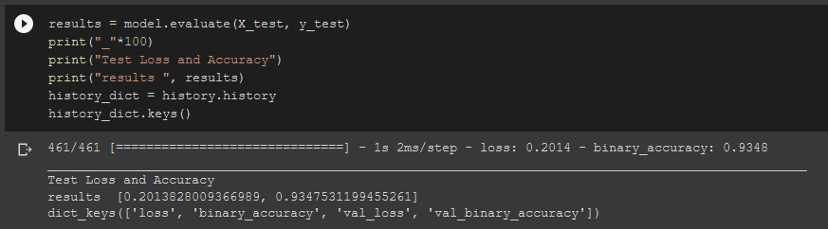
Neural Network Performance Metrics

Slide 15
Comparative Results
INFERENCE
RANDOM FOREST CLASSIFICATION : 93.5%
DECISION TREE CLASSIFICATION : 90.1%
SUPPORT VECTOR MACHINE(SVM) : 92.6%
NEURAL NETWORKS(NN) : 93.4%
From above results we can conclude that Random Forest performed well on our dataset to predict mortality as compared other algorithms.

Slide 16
Challenges
Data preprocessing is one of the challenges as many of important features are in categorical format and needed to be encoded.
Data needed to be normalized
Another challenge for this project is selecting the appropriate Classification Model based on performance

Slide 17
Outcome of Project
We sought to develop an model which will correctly predict what are the chances of patient’s survival using the physiologic signals and vital signs which were captured from patient monitors, and comprehensive clinical data obtained from hospital medical information systems, for tens of thousands of Intensive Care Unit.
We also compared the output of different techniques and concluded which model performed well among all others.

Slide 18
Conclusion
We have analysed and performed Exploratory Data Analysis upon the MIMIC-III dataset
We have performed classification upon the dataset based on the various features and implemented different types of classification algorithms to determine which algorithm performs best.
We have concluded that Random Forest Classifier performs the best with the dataset at 93.5%, with Sequential Neural Network model coming second at 93.4%.

Slide 19
References
https://translational-medicine.biomedcentral.com/articles/10.1186/s12967-020-02620-5#Sec2

Slide 20
Thank You

